Slide 1


Slide 2

Hotel Management Presentation

Slide 3

Our Teammates
G.PREETHI -24kb1a0492
M. ROHINI-24kb1a04m5
J.NIKITHA-24kb1a04c0
G.SUJANA-24kb1a0493
K.SARANYA-24Kb1a04f4
D.CHANADANA-24kb1a0477

Slide 4

Introduction
Hotel management is the administration and operation of a hotel or hospitality establishment, with a focus on providing high-quality service, ensuring guest satisfaction, and maximizing profitability. This field encompasses a broad range of responsibilities, including overseeing staff, managing day-to-day operations, maintaining facilities, budgeting, marketing, and ensuring that the hotel meets the needs of its guests while operating efficiently.

Slide 5

KEY FEATURES
Updates online bookings, cancellations, and room statuses in real-time to reduce errors and miscommunication
Uses data and analytics to predict demand and guest behavior
Provides detailed reports on hotel operations to help improve operations and increase revenue

Slide 6
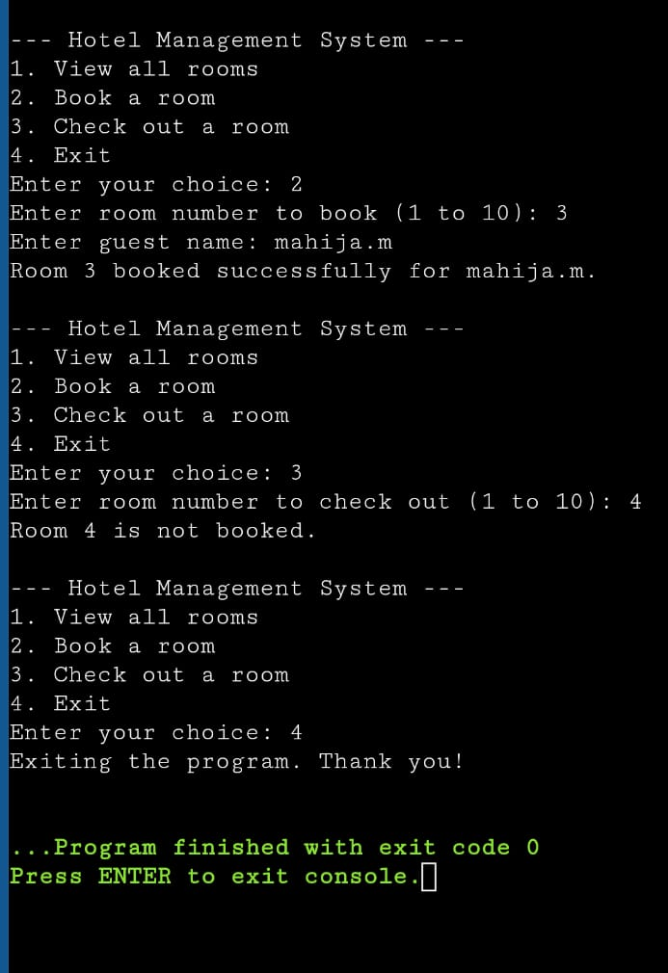
HOTEL MANAGEMENT
AIM: Write a C program to hotel management.
SOURCE CODE:CLICK HERE TO VIEW THE SOURCE CODE
OUTPUT:

Slide 7


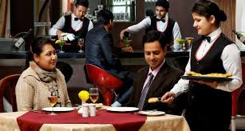
CONCLUTION
The future of hotel management may include more technology, sustainability, personalization, and a focus on guest well-being. Hotel managers who adapt to changing guest expectations and embrace these innovations can create exceptional guest experiences.

Slide 8


